Slide 1
ENGI 301 PocketPlant Proposal
2/19/2024
Amelia Pillar

Slide 2
Background Information
I used to only have fake plants in my room because I’m terrible at keeping them alive, but I recently purchased a mint plant on a whim
Automatic plant waterers are a common DIY project, but I want to add extra functionally to suit the needs of a busy college student and help make sure I don’t pick too many leaves at once
Some existing solutions
https://www.hackster.io/fernandalago/plant-reminder-box-473f95: soil moisture sensor and light sensor, sends text alerts when water low or light bad
https://www.hackster.io/rhealv/plant-watering-system-without-relay-e25e6b: waters plant based on water sensor

Slide 3
Background Information
Combine parts of these ideas plus added functionality
Record keeping of harvests: could apply to any indoor herb garden
Light sensor and tri-color LED to correct for poor/inconscient dorm room lighting
Display when water tank is low (calculate how much plant has been watered)
Project will consist of watering and moisture monitoring, light adjustment and light monitoring, and a harvest log
User will interface via a joystick to toggle through display and log harvests
display: last harvest, water tank level, last watered, light “quality”

Slide 4
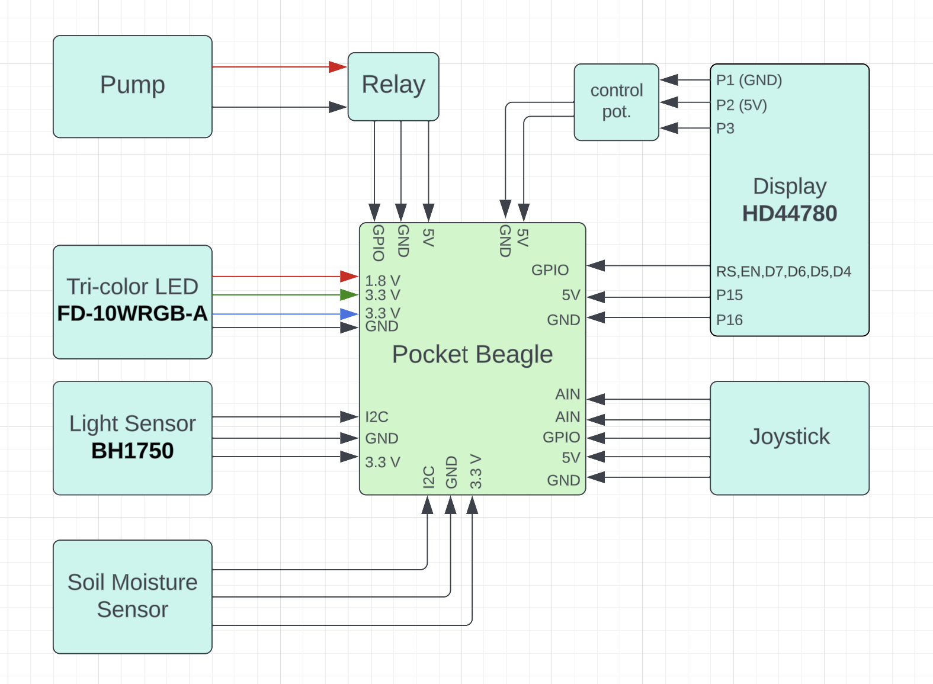
System Block Diagram
Note: For the joystick, AIN on the PocketBeagle are 3.3 V and 1.8 V, will have to use resistors to bring it to the right voltage or under
Notes:
Create a System Block Diagram
Label interfaces / pins
Components (part numbers if possible)
joystick – AIN on pb are 3.3 and 1.8 , use resistor to bring it to the right voltage or under

Slide 5
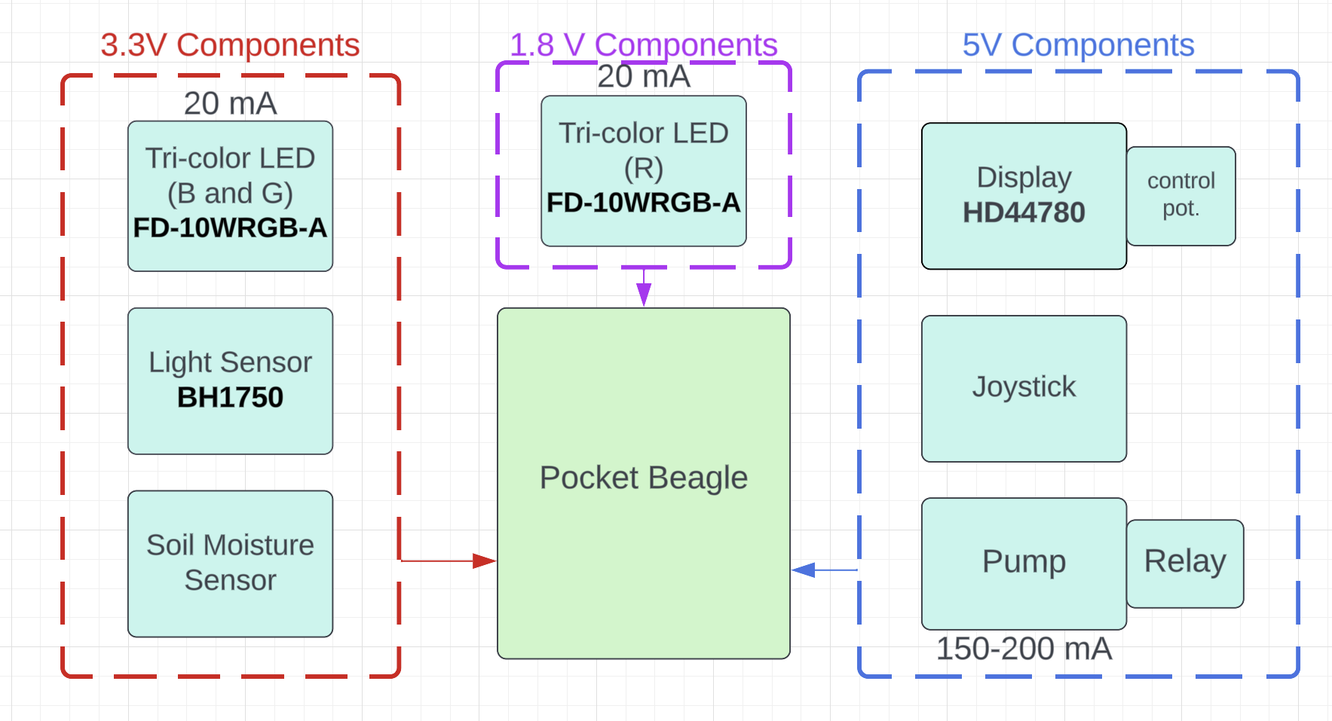
Power Block Diagram
Note: The tri-color led has to be transistor controlled because the PocketBeagle can’t supply 20 mA of current
Notes:
Need All Power Inputs and Outputs
tri-color led – transistor controlled bc pb can’t supply 20 ma of current

Slide 6
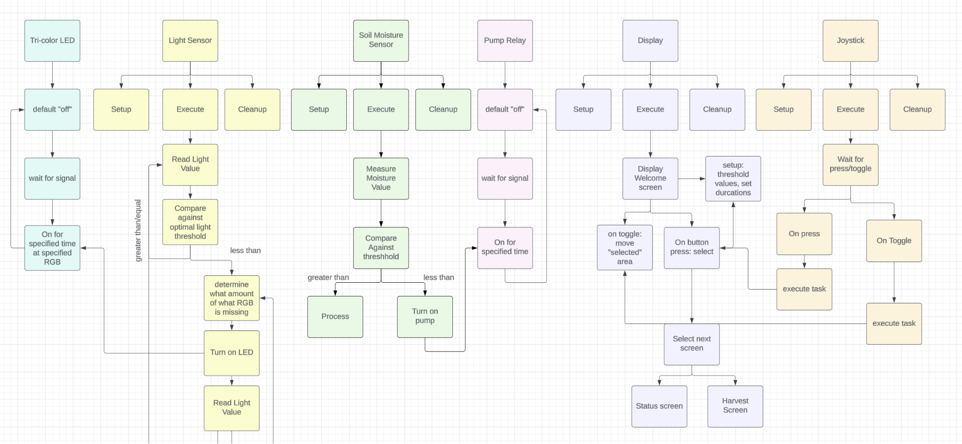
Software Block Diagram

Slide 7
Components / Budget
Component | ENGI301 to Buy? | Cost
Soil Moisture Sensor | yes | 8.99
Standard LCD 16x2 | yes | 9.95
Pump | yes | 6.99
Joystick | yes | 13.29
Light Sensor | yes | 4.50
tri-color LED | yes | 9.95
Relay | yes | 9.99
Note: Component cost adds up to more than $35. Since a few of these components come in packs of more than 1, maybe can split with someone else, or find a cheaper option.
Notes:
lcd might be limiting – spi screen? can do a lot more in terms of display with it

